Slide 1
Office of Field Services Spring Workshop 2016
Notes:
When you are ready to begin the workshop, project this slide and say:
Thank you for joining us today. This presentation is an opportunity for the Office of Field Services to present updates for successful planning, implementation, monitoring and evaluation of supplementary programs, as administered by the Michigan Department of Education. I am _______ from the Office of Field Services.

Slide 2
Overview of Today’s Agenda
Participant Activity
Title I, Part A Schoolwide Flexibility
Every Student Succeeds Act (ESSA) Updates
Common Fiscal Findings
31a Updates
Application Changes
General Questions/Comments
Notes:
This is an overview of today’s agenda. (Give the audience time to read the slide.)
(more detail will be provided on the following slides.)

Slide 3
Participant Activity
Notes:
Each Region can facilitate this activity in a manner that meets their needs. Here is an example.
Divide participants into small groups.
Give each group a sheet of presentation paper and a marker.
Ask them to list specific questions that the group participants would like answered during the workshop.
Ask them to post their questions.
At the end of the workshop, peruse each list and answer/clarify questions that have not been adequately addressed.

Slide 4
Every Student Succeeds Act Title I, Part A Schoolwide Flexibility
Coming soon to a Title I, Part A Schoolwide School near you!

Slide 5
Title I, Part A Schoolwide Overview
A schoolwide program is a comprehensive reform strategy designed to upgrade the entire educational program in a Title I school supported by Every Student Succeeds Act (ESSA) Title I funds.
Its primary goal is to ensure that all students, particularly those subgroups that are low-achieving, demonstrate proficient and advanced levels of achievement on State academic achievement standards.
Notes:
Schoolwide programs are not new. In 1988, the Hawkins-Stafford Elementary and Secondary School Improvement Act of ESEA added a provision to the legislation that allowed for greater flexibility in schoolwide projects.
A schoolwide program is a comprehensive reform strategy designed to upgrade the entire education program in a Title I, Part A school.
Under the newly authorized Every Student Succeeds Act, Title l, Part A Schoolwide programs continue to focus on meeting the needs of students in the entire school, but particularly children who are failing or are at risk of failing to meet challenging state academic standards and other factors determined by the local educational agency (LEA).

Slide 6
A New Day: More Flexibility
New steps are being taken at the United States Department of Education (USED) and the Michigan Department of Education (MDE) to ensure that LEAs and schools fully leverage and maximize Title l, Part A Flexibility resources to improve student performance.
Notes:
The U.S. Department of Education is taking new steps to ensure that the flexibility afforded schoolwide schools is maximized. Guidance was issued to the states by the U.S. Department of Education in July 2015 highlighting Title I, Part A Schoolwide implementation myths and clarified the law.
MDE is working to help LEAs leverage their Title I, Part A Schoolwide funds to improve student performance through this flexibility.

Slide 7
Requirements-Districts/Schools Must:
Ensure that the “intents and purposes” of Title I are maintained;
Meet the test of “supplement not supplant”;
Conduct a comprehensive needs assessment;
Create a comprehensive schoolwide plan; and
Conduct an annual review of the effectiveness of the schoolwide program, and revise the plan as necessary.

Slide 8
Fulfillment of Intent And Purposes
Schools must be able to show their ability to fulfill the intent and purposes of Title I, Part A.
The purpose is to ensure that all children have a fair, equal, and significant opportunity to obtain a high-quality education and reach, at a minimum, proficiency on challenging State academic achievement standards and State academic assessments.
Notes:
Fulfillment of Intents and Purposes
LEAs must provide assurances that the Intents and Purposes of Title I, Part A are maintained and monitored for successful attainment.
Refer to “Resources” on the Schoolwide Flexibility Templates

Slide 9
Every Student Succeeds Act (ESSA) Section 1008 (a) (2) (B)
(B) SUPPLEMENTAL FUNDS.—In accordance with the method of determination described in section 1118(b)(2), a school participating in a schoolwide program shall use funds available to carry out this section only to supplement the amount of funds that would, in the absence of funds under this part, be made available from non-Federal sources for the school, including funds needed to provide services that are required by law for children with disabilities and English learners.
Notes:
Schools may use the Title I, Part A funds to supplement the amount of funds that would, in the absence of funds, be made available from non-federal sources.

Slide 10
Test of Supplement Not Supplant
Schools must meet the basic test of supplement not supplant.
An LEA is required by State or local law to provide funding for a specific purpose for all students.
Notes:
The Test of Supplement not Supplant is where the implementation clarification and flexibility will be most evident.
Schools must meet the basic test of supplement not supplant.
An LEA is required by State or local law to provide funding for a specific purpose for all students.

Slide 11
Comprehensive Needs Assessment
The needs assessment is critical to developing a schoolwide program, as it reveals the priority areas on which the program will focus.
The needs assessment guides the development of the comprehensive schoolwide plan and suggests benchmarks for its evaluation.
Notes:
In Section 1114 (b)(6), ESSA provides a description of the elements needed in a Comprehensive Needs Assessment. The Office of Field Services has developed a rubric to help LEAs identify needed components of the Comprehensive Needs Assessment.
The Comprehensive Needs Assessment is the first component in the Schoolwide Diagnostic which is an ongoing process and includes Demographic, Achievement, Perception and Process Data.

Slide 12
Approved Comprehensive School Improvement (Schoolwide) Plan
The school must develop a comprehensive school improvement (schoolwide) plan that describes how it will achieve the goals it has identified as a result of its needs assessment.
Notes:
LEAs must also have a district improvement plan approved by the State. (Section 1006. Local Educational Agency Plans)
The comprehensive school improvement plan contains the SSR 40/90, the School Data Analysis, the Schoolwide Diagnostic, and the School Improvement Plan.

Slide 13
Annual Monitoring and Evaluation
The school must evaluate annually the outcomes and the plan’s implementation to determine whether the academic achievement of all students, and particularly of low-achieving subgroups, improved, whether the goals and objectives contained in the plan were achieved, and if the plan is still appropriate as written.
Notes:
LEAs are required to annually evaluate the outcomes and plan’s implementation. All programs/activities funded by federal funds should be evaluated, however, the MDE has recommended that LEAs use the Program Evaluation Tool (PET) to evaluate the effectiveness of “broad” building and district level programs that have been funded by Title I, Part A and other sources.
The evaluation of the use of funds is a state requirement under PA 25. The Program Evaluation Tool must still be used to evaluate one of your programs, initiatives, or strategies.

Slide 14
Next Steps
If you choose to participate in Title I, Part A Schoolwide Flexibility:
Indicate “Participate in Title I, Part A Schoolwide Flexibility” status in the Title I School Selection (TISS).
Complete and upload Title I, Part A Schoolwide Flexibility templates1 and 3 in the Consolidated Application.
Notes:
These two bullets will be explained later in the presentation. Screen shots are available in the MEGS+ slides, later in the presentation.
Present the SW Flexibility Template Handout.

Slide 15
Remember-Conferring With Your Stakeholders Is Critical!
Who are the school-level stakeholders needed to help ensure success in implementing schoolwide flexibility in your district?
Notes:
You should identify your Schoolwide Flexibility Planning Team. Who are the stakeholders needed to help ensure the maximized success of your program?
School-level stakeholders: Teachers, Principal, Parents, School Board Members, Community Members, Students (if appropriate), Education Service Provider Representatives, etc.
Remind that flexibility is done at the school-level and found in the school-level budget.

Slide 16
Every Student Succeeds Act (ESSA) Update

Slide 17
ESSA Updates
“Dear Colleague” letter sent from USED to state departments of education on January 28, 2016.
2016-17 will be a transition year except for a few key items.
Formula grants will be made the same way for 2016-17 as they were for 2015-16.
LEAs will operate under the procedures and requirements for formula grants that were in place for 2015-16.
Notes:
Based on a “Dear Colleague” letter sent from the U.S. Department of Education to all state departments of education on January 28, 2016, regarding the transition to ESSA, and the “Transitioning to ESSA FAQ” from the USED Website

Slide 18
ESSA Updates
Elimination of “highly qualified” (HQ) requirement for all teachers of core academic subjects (Section 1119) and requirement to create and implement an improvement plan for LEAs not making progress toward all teachers being “HQ”.
HQ requirements are in place through the end of 2015-16 school year per USED. They remain in place for teachers under State Board of Education policy until further notice…through the 2016-17 school year, at least.
LEAs do not need to ensure paraprofessionals meet certain qualifications.
Notes:
Based on a “Dear Colleague” letter sent from the U.S. Department of Education to all state departments of education on January 28, 2016, regarding the transition to ESSA, and the “Transitioning to ESSA FAQ” from the USED Website.
Bullet #2-per Krista Ried, Manager of Professional Educator Certification and Services Unit, Office of Professional Preparation Services

Slide 19
ESSA Updates
LEAs must continue to ensure that poor and minority children are not taught at higher rates than other children by inexperienced, unqualified, or out-of-field teachers (ESEA Section 1111(b)(8)(C)). Requirement will stay in effect during the 2016-17 school year.
LEAs need not notify parents when a child has been assigned to, or has been taught for four or more consecutive weeks by a teacher who is not highly qualified.
Notes:
Based on a “Dear Colleague” letter sent from the U.S. Department of Education to all state departments of education on January 28, 2016, regarding the transition to ESSA, and the “Transitioning to ESSA FAQ” from the USED Website

Slide 20
Title III ESSA Updates
Title III Annual Measurable Achievement Objectives (AMAOs) determinations are on hold for 2014-15 and 2015-16. An LEA that was implementing an improvement plan in the 2015-2016 school year (or earlier), must continue to implement the improvement plan in the 2016-2017 school year.
LEAs receiving Title III funds do not need to provide notice to parents for not meeting AMAOs if such determinations were made for 2014-15. In Michigan, the last AMAO calculations were completed for 2013-14 and notices to parents were still required.
Notes:
Based on a “Dear Colleague” letter sent from the U.S. Department of Education to all state departments of education on January 28, 2016, regarding the transition to ESSA, and the “Transitioning to ESSA FAQ” from the USED Website
States must continue to provide technical assistance and support to each such LEA for any previously determined AMAOs and improvement plans.

Slide 21
McKinney-Vento ESSA Updates
McKinney-Vento (M-V) students attending any school in the LEA are automatically eligible for Title I, Part A services.
District Improvement Plans must:
Include timely and meaningful consultation with the M-V liaison
Be coordinated with M-V programs
Describe the services provided to M-V students, including with reserved funds, to support their enrollment, attendance, and success

Slide 22
McKinney-Vento ESSA Updates
As of Dec. 10, 2016 – “Awaiting foster care placement” is removed from M-V Law, and foster youth will no longer be identified as “Homeless,” though M-V services must continue through 2016-17 SY.
Effective July 1, 2017 (implementation in 2017/18 school year): All children in any level of foster care are to be supported through Title I, NOT M-V.
For 2016-17, Districts receiving Title I funds must continue to reserve funds for homeless students in non-Title I buildings.
Notes:
Details will be provided and discussed at the Special Populations conference (September 19-20)

Slide 23
McKinney-Vento ESSA Updates
Title I changes related to M-V Homeless Education are effective July 1, 2017.
SEA must have a State Coordinator for the Education of Foster Youth
State Child Welfare Agency (DHHS) will be responsible for providing transportation for foster youth to schools of origin, when in the best interests of the student
State Report Cards will include disaggregated graduation rates and academic achievement of homeless and foster youth
Notes:
Details will be provided and discussed at the Special Populations conference (September 19-20)
Foster care youth transportation provided by DHHS.

Slide 24
Additional Functions Required for M-V District Liaisons
LEA must ensure the time and capacity of the liaison to perform required duties.
Public notice of educational rights must be in a form/manner that is understandable.
Ensure school personnel providing any services under M-V receive professional learning and other support.
MDE will be providing support. Information will be coming later.
Notes:
Details will be provided and discussed at the Special Populations conference (September 19-20)

Slide 25
Additional Functions Required for M-V District Liaisons
Ensure Unaccompanied Homeless Youth are immediately enrolled and informed of independent status for FAFSA, as well as providing verification of that status.
Liaisons who receive appropriate training may now affirm eligibility of family or youth for HUD Housing Assistance.
LEAs must demonstrate they have reviewed and revised, developed and implemented policies and procedures to eliminate barriers to the identification, enrollment retention, and success of homeless children and youth.
Notes:
Details will be provided and discussed at the Special Populations conference (September 19-20)
FAFSA=Free Application for Federal Student Aid
HUD=Housing and Urban Development

Slide 26
Office of Field Services Common Findings During Fiscal Review Process
Juan Suasto
May 2016

Slide 27
Common Findings
Obligation date of the Consolidated Application.
10% deviation of expenditures (Prior Approval document posted on Office of Field Services website).
Lack of policies and procedures to ensure proper internal controls are in place, implemented, and properly monitored.
Written procedures (and policies) are not detailed and specific to the LEA.
Notes:
Box 7 of the award letter
Expenditures are being found prior to the expenditure period beginning date.
Mention the earliest obligation date is July 1, 2016. In order to receive an obligation date the districts must complete and submit their TISS/Consolidated Application in substantially approvable form, their Program Evaluation Tools and their District Improvement Plan.
If a district completes all of the requirements by the end of May 2016 the consultant will have the application reviewed and returned to the district before school starts.
Expenditures are being approved by line item and any expenditure exceeding approval by greater than 10% will be questioned
Desk procedures for the business office functions

Slide 28
Common Findings
Proof of criminal background checks missing.
Expenditures not readily identifiable and/or approved in the Consolidated Application.
Questioned costs
Misclassified costs
Inventory list of items purchased with federal funds not maintained.
Equipment purchased with federal funds not tagged with the funding source.
Notes:
We are looking at one or more of these documents Ichat, Tracking Control Number (TCN) or red light/green light letter). We are no longer allowed to review the original criminal background checks. Information about getting access to Ichat call 517 241-0713 or email ichathelp@Michigan.gov. Ichat service is FREE to schools.
Questioned costs are expenditures that were NOT approved in the Consolidated Application or did not meet grant requirements and can be recaptured.
Misclassified costs are expenditures that were approved but expensed to the wrong building, function code or object code. These costs will NOT be recaptured.
Any piece of inventory greater than $100 each with a useful life greater than one year, should be on your inventory list. The inventory list must contain the following: Description of the property, serial number or other identification number, source of the property, who holds title, the acquisition date, and cost of the property, percentage of federal participation in the cost of the property, the location, use and condition of the property, and any ultimate disposition data including the date of disposal and sale price of the property.

Slide 29
Common Findings
LEA could not provide adequate documentation for cash draws.
LEA’s budget approved by Board does not align with LEA’s Consolidated Application.
Free eligible lunch counts are being misreported. Then LEAs are asking for an appeal after the data has been submitted to USED.
Notes:
Cash draws should have supporting documentation available for each draw
The general ledger budget is not updated to agree to the amended Consolidated Application budget.
LEAs are not reporting and/or misreporting free eligible lunch counts in the MSDS through the supplemental nutritional eligibility collection (SNE). This occurs in October. Once the data is submitted to USED there is no appeal option with MDE or CEPI. There is a 3 week validation period after the SNE Fall collection closes. Actual free eligible lunch data is required for calculating allocations for Title I and 31a. The community eligibility program status of a school cannot be used for allocation purposes.

Slide 30
Timekeeping
Cost Objective:
A function, organizational subdivision, contract, grant, or other activity for which cost data are needed and for which costs are incurred.
Notes:
Read Slide

Slide 31
Timekeeping
Semi-Annual Certification:
A certification that the employee worked solely on a single program or cost objective.
Notes:
Read Slide

Slide 32
Timekeeping
When an employee works 100% on a single cost objective, a semi-annual certification must be:
Prepared after-the-fact (dated); and
Prepared at least every 6 months (semi-annually); and
Coincide with one or more pay periods; and
Account for total activity for which the employee is compensated; and
Signed by the employee or supervisor official having firsthand knowledge of the work performed.
Notes:
Read Slide

Slide 33
Timekeeping
Personnel Activity Report (PAR):
A record maintained by an employee who works on multiple activities or cost objectives.
Notes:
Read Slide

Slide 34
Timekeeping
When an employee is assigned to work on multiple cost objectives, the PAR must:
Reflect an after-the-fact distribution (dated) of the employee’s actual activity; and
Be prepared at least monthly; and
Coincide with one or more pay periods; and
Account for total activity for which the employee is compensated; and
Be signed and dated by the employee and supervisor.
Notes:
Read Slide
Remind Participants that all employees, whether they complete a semi-annual or PAR, must also keep activity logs to back up the time keeping documents.

Slide 35
Timekeeping: Decision Making Rubric
Cost Objective
When to do a Semi-Annual Certification or a Monthly Par?
Grant Awards (or funding source) | Single | Multiple
Single | Do Semi-Annual Certification (A) | Do Monthly PAR (C)
Multiple | Do Semi-Annual Certification (B) | Do Monthly PAR (D)
Notes:
Read Slide

Slide 36
Updated Section 31a Information
Literacy, MTSS, and Career/College Readiness
Notes:
Revised Report
Professional Development
Anti-bullying/crisis intervention
K-3 literacy
Early literacy programs
Multi Tiered System of Supports

Slide 37
Focus on Literacy, K-3 & Career/College Readiness by the End of 11th grade
Focus on 3rd grade literacy proficiency and the accountability model that ensures all at-risk students will be proficient in ELA at the end of grade 3 or significant consequences will be assessed.
A continuing focus on the preparation of 11th grade at-risk students to be career and college ready. As with the consequences imposed against districts whose students are not reading-proficient, districts should focus on this prior to 11th grade.
Notes:
Consequences: Penalized by ½ of allocation times % identified at-risk not proficient/career college ready.
Goes into effect after 2017-18 data collection

Slide 38
Multi-Tiered System of Supports (MTSS) Legislative Language
Implements effective instruction for all learners,
Intervenes early,
Provides a multi-tiered mode of instruction and intervention that provides the following:
A core curriculum and classroom interventions available to all pupils that meet the needs of most pupils,
Targeted group interventions,
Intense individual interventions,
Notes:
MTSS Legislation was effective October 1, 2015.

Slide 39
Multi-Tiered System of Supports (MTSS) Legislative Language
Monitors pupil progress to inform instruction,
Uses data to make instructional decisions,
Uses assessments, including universal screening, diagnostics, and progress monitoring,
Engages families and the community,
Implements evidence-based, scientifically validated, instruction and intervention,
Implements instruction and intervention practices with fidelity,
Uses a collaborative problem-solving model.
Notes:
Directly from legislation.

Slide 40
Annual Section 31a Program Report
Modifications were made in the report to address language in the legislation: professional development, early literacy, anti-bullying programs, crisis intervention, and parental engagement.
Due date: July 15, 2016
Notes:
REMINDER: Please remember that Section 31a does not support expenses related to administrative activities such as a Dean of Students and Attendance Officer.

Slide 41
MEGS+ Application Changes
Notes:
Changes to the FY 2017 Consolidated Application and TISS are related to Schoolwide Flexibility and Alternative Language Template.

Slide 42
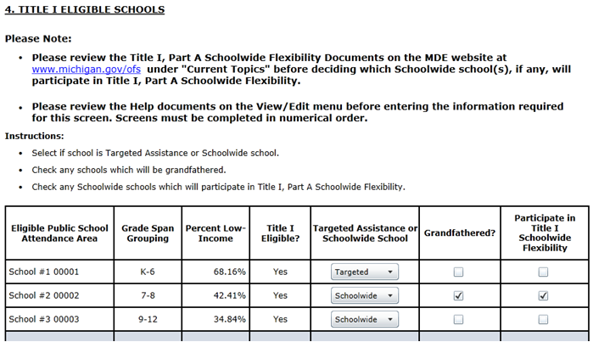
Long Form Title I School Selection
Notes:
The major addition to the 2016-17 Title I School Selection (TISS) application is a new column entitled “Participate in Title I Schoolwide Flexibility” in Screen 4, Title I Eligible Schools, and Screen 7, Title I School Served.
LEAs will check a box if the Title I Schoolwide school(s) will be participating in Title I, Part A Schoolwide Flexibility. The LEA will receive a MEGS+ error message if they check the box for a Targeted Assistance school.

Slide 43
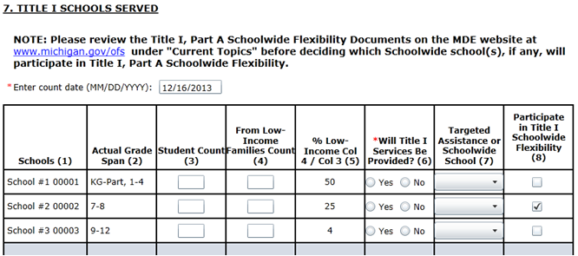
Short Form Title I School Selection
Notes:
This is a screen shot of what that looks like in the short form of the Title I School Selection

Slide 44
Consolidated Application Attachment
TITLE I, PART A SCH0OLWIDE FLEXIBILITY DOCUMENTS (IF APPLICABLE)
These attachments are only required for Local Educational Agencies (LEAs) with Schoolwide (SW) schools participating in Title I, Part A Schoolwide Flexibility.
Instructions:
Step 1:
Go to the MDE website at www.michigan.gov/ofs,
Notes:
The major addition to the 2016-17 Consolidated Application is a new Attachment link for “Title I, Part A Schoolwide Flexibility Documents (if applicable)”. They will be posted under “Title I, Part A Schoolwide Flexibility documents and templates” on the OFS website prior to the 2016-17 Consolidated Application going live in MEGS+ in late April or early May.
The templates provide:
1. Explanation of how the state and local funding is distributed.
2. Listing of historical funding for each school.
3. Description of intent and purpose for each participating school.

Slide 45
Consolidated Application Attachment Cont’d
Under “Current Topics” click on the ‘Title I, Part A Schoolwide Flexibility” link to access the appropriate downloadable Title I, Part A Schoolwide Flexibility Template documents.
Title I, Part A Schoolwide Flexibility Template 1 – Methodology – Assurance and Guiding Questions (Assurance Check submission required – Completed question submission not required)

Slide 46
Consolidated Application Attachment Cont’d
Title 1, Part A Schoolwide Flexibility Template 2 – Supplemental Funds Test (NOTE: Template 2 is an example of a methodology test and may be uploaded, but, is NOT required for submission.)
Title I, Part A Schoolwide Flexibility Template 3 – Meeting Intent and Purposes of Title I, Part A (Submission required)

Slide 47
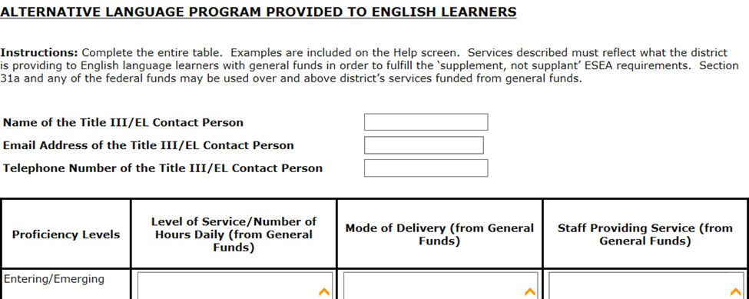
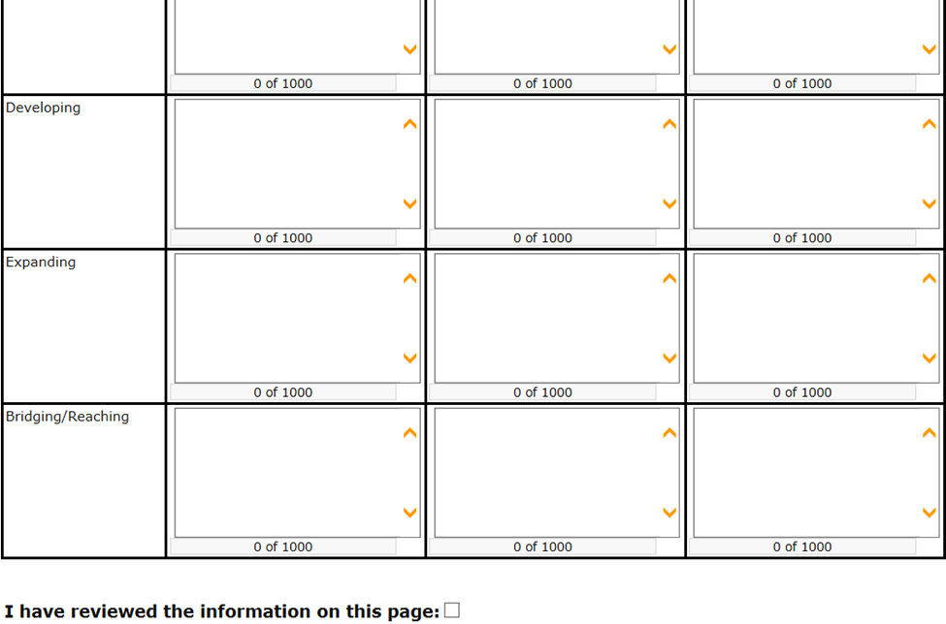
Consolidated Application Alternative Language Template
Notes:
The other change in the 2016-17 Consolidated Application is the information entered by LEAs in the “Alternative Language Program Provided to English Learners” will be pulled forward from the 2015-16 Consolidated Application. LEAs will be required to indicate their review of the information pulled forward prior to submitting their 2016-17 Consolidated Application. This can be done by checking the “I have reviewed the information on this page” box at the bottom of the screen.
MEGS+ will generate the following error message it they forget to check the box: “You must check the box verifying that you reviewed this information.”

Slide 48
Review Participant Questions
Notes:
Review the questions that participants had at the beginning of the workshop. Provide answers to any that need further clarification.

Slide 49
Resources
MDE/OFS Website
www.michigan.gov/ofs
USED ESSA FAQ
http://www2.ed.gov/policy/elsec/leg/essa/faq/essa-faqs.pdf
Notes:
This concludes our OFS workshop. Additional information on the covered topics and much more can be found on our website.

Slide 50
Top 10 in 10
Top 10 in 10 Years
Putting Michigan on the map as a premier education state
Our collective efforts can help make Michigan a Top 10 education state in 10 years! Here are the goals and strategies: http://mi.gov/top10in10.

Slide 51
Contacting OFS
All Regions 517-373-4004
Special Populations 517-373-6066
Homeless; Title III (EL & Immigrant); Section 31a; Section 41; Title I, Part C (Migrant); Title I, Part D (Neglected and Delinquent)
Financial Unit 517-373-2519
Director’s Office 517-373-3921
Notes:
Office of Field Services Regional and Special Populations Consultants will be happy to provide assistance or answer questions concerning information in this update or on any topics regarding state and federal supplemental programs.

