Slide 1

Consultation Meeting between
Public and Private Schools
Kent Intermediate School District
and Local School Districts
October 22, 2019

Slide 2
Federal Special Education
Law – IDEA 2004
IDEA requires timely and meaningful consultation between public and private schools.
IDEA requires districts to determine number of students with disabilities in private schools.
IDEA requires districts to spend a “proportionate share” of funds on students in private schools.

Slide 3
Registered Sites
ALL Nonpublic Schools and Homeschool Sites MUST register annually with the Michigan Department of Education in order for their students to be able to receive special education related services.

Slide 4
Michigan’s Special Education and Auxiliary Services Laws
District where the private school is located is responsible for child find, evaluations, and
provision of related services (speech, social work, OT, PT) for children grades K-12.
Resident district is responsible for programming but it must be provided at a public school.
Shared Time is permitted for non-core and some special education classes, but transportation is not provided across districts.

Slide 5
Shared Time
Eligible courses
  Physical education
  Art
  Foreign language
  Career Technical Education
Ineligible courses
  Math
  Reading
  English
  Writing
  Science
  Social Studies

Slide 6

Who Serves Preschoolers Attending Private Schools?
Michigan’s Auxiliary Services Act covers students in grades K through 12.
Preschool children with disabilities are entitled to special education programs/services, but it is the responsibility of the resident district to conduct evaluations and offer needed services.

Slide 7
Initial Evaluations and Prior Evaluations
An evaluation of a nonpublic student is still an initial evaluation if a prior evaluation was done:
  By a private school or other private provider
  By a public school and the student was found to be ineligible
  By a public school and the student was found to be eligible, but the parent revoked consent for the provision of all special education programs/services

Slide 8
Next Step: Eligibility and the Parent Decision
When the evaluation indicates educational needs necessitating special education, the nonpublic parent may choose to:
  Enroll the student in the resident public district to help develop an IEP with special education programs (and possibly services)
  Decline all special education
  Decline all programs and accept a Nonpublic Service Plan for ancillary services from the public district of location
  Fill out a Parent/Guardian Notice of Intent to Voluntary Enroll in a Private School
    *Stops the process and absolves the District of Residence to offer FAPE

Slide 9

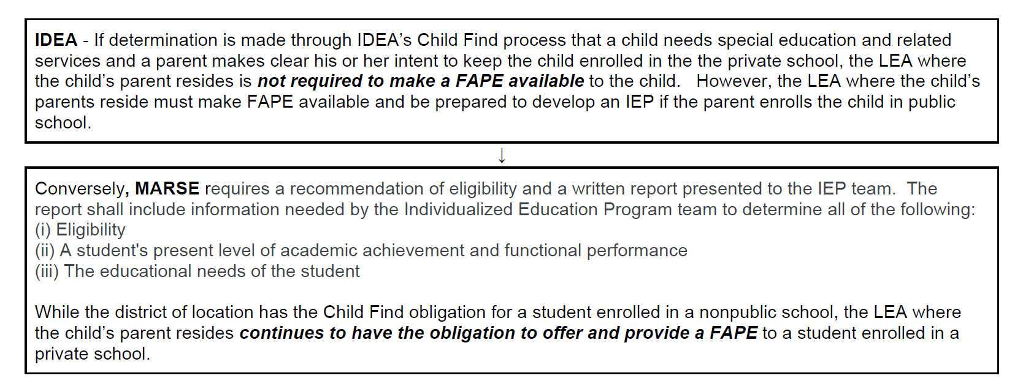
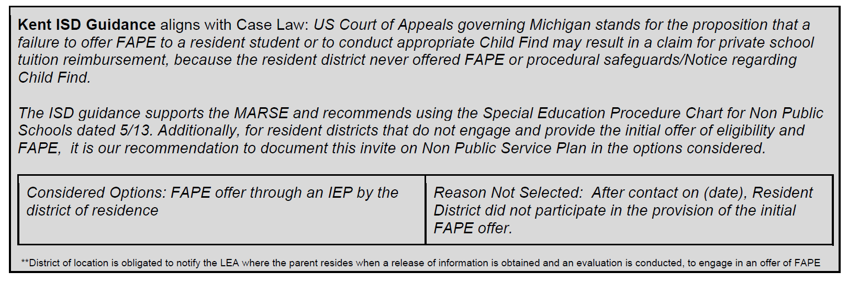
Providing Services to Students who are Voluntarily Enrolled in Nonpublic Schools

Slide 10
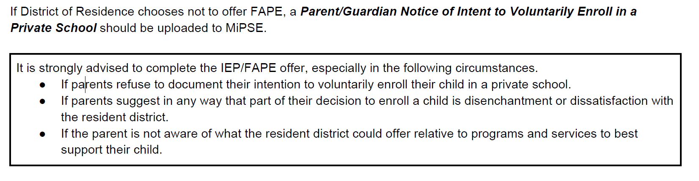
Providing Services to Students who are Voluntarily Enrolled in Nonpublic Schools

Slide 11
Case 1: IEP for FAPE in the Resident District
If student requires a special education program, an IEP should be developed and a program provided in the resident district.
  Unless Parent/Guardian provides the Notice of Intent to Voluntarily Enroll in a Private School. - Document on the Notice page of the Nonpublic Service Plan.
Students who are shared time in the resident public district (for non-core classes) and nonpublic school receive programs and/or services in the resident district.
Pre-K students are the responsibility of the resident district and receive programs and/or services through an IEP.

Slide 12

Case 2: Documenting a Parent Decision to Decline All Special Education
Resident nonpublic student - The initial eligibility determination, initial offer of a FAPE through special education, and the parent decision to decline all special education should be documented on an IEP form.
Nonresident nonpublic student - The initial eligibility determination, initial offer of special education, and the parent decision to decline special education ancillary services should be documented on a Nonpublic Service Plan form
Unless Parent/Guardian provides the Notice of Intent to Voluntarily Enroll in a Private School. - Document on the Notice page of the Non Public Service Plan

Slide 13

Case 3: Parent Accepts a
Nonpublic Service Plan From the Local Public District
Resident and nonresident nonpublic students – The public district of location develops a Nonpublic Service Plan for special education ancillary services (only).

Slide 14

Tracking Students Who Are Eligible But Have Refused Services
Public schools must track students who were found to be eligible for special education, but whose parents declined services.
Evaluations may be done every 3 years, if desired (with parent consent). We have a form for this.

Slide 15
Three-year Reevaluation for
Nonpublic Students
The public district of location must offer a redetermination of eligibility at least every 36 months to eligible nonpublic students, even if not currently receiving services.

Slide 16

Special Education Transportation

Slide 17
Special Education Transportation
Public schools typically provide bussing to and from private schools for special education students in their boundaries (to the same extent they transport their public school students).
Public schools are not obligated to provide transportation to private school students across district lines.
However, some districts may transport private school students across lines if a bus is going in the general direction at the same time.

Slide 18
Annual Count
Each ISD must:
  Ensure that the count is conducted between October 1 and December 1 of each year (Official Fall count)
  Use the prior year count to determine the amount the ISD must spend on providing special education and related services in the next fiscal year

Slide 19
Eligible Children with Disabilities
The Proportionate Share for parentally placed private school children with disabilities is based on total children eligible to receive special education and related services, not just those served.

Slide 20
Allowable Costs
Time documenting therapy notes of direct service- YES
Time to prepare or plan for services- YES
Time for related service providers to consult regarding services- YES
Time to travel to and from the district to the non-public school- YES
Mileage costs to travel to and from the district to the non-public school- YES

Slide 21
Non Allowable Costs
Child Find- NO
Evaluations and Re-evaluations- NO
Administrative Costs (Indirect Costs)- NO
Consultation Meeting- NO
Prep time for Service Plan Meeting- NO

Slide 22

How We Calculate
Proportionate Share
Number of eligible children ages 3-21
Number of parentally placed eligible children in private schools
Total number of eligible children
Total IDEA allocated flowthrough Funds divided by number eligible= average allocation per eligible child
Multiply by number of parentally placed children
Total Proportionate share Requirement

Slide 23
Proportionate Share Preschool Grant
Same calculation for Preschool Grant (children 3-5)

Slide 24

Time for Local District Consultation on Four Other Topics

Slide 25
Discussion Areas
Child Find Process Used
Consultation Process Used
Special Education Services Provided by Public Schools
Problem-Solving Approaches and Opportunity for Questions

